Slide 1
FANTASY BALL
DFS 1 Proposal – By Rahul Gupta

Slide 2
What Is Fantasy Ball ?
Fantasy Ball is a brick breaker type game. The player can move a paddle side to side to avoid the ball from falling into the pit while trying to break the bricks in the level and maximize the score. There are multiple variants of Brick breaker games, namely some of them are Dx-Ball, Breakout, Brick Breaker, Grove Flowers, etc. Each of these have variances in terms of art style & the abilities of the paddle, the ball, the bricks themselves and scoring mechanics but the core loop in all these remain the same i.e. breaking bricks, avoiding the ball to fall below the paddle ( avoiding death ) and maximizing score.

Slide 3
Other Brick Breaker Games over the Years
Piffle
DX-Ball 2
Grove Flowers

Slide 4
What is the aim with Fantasy Ball ?
For this DFS project, I plan to create a Forest Fantasy themed brick breaker game with a limited number(for now the plan is at least 3) of levels that can be painted using a chroma key or use a procedural level generation algorithm if they don’t feel sufficient. For the game to feel fun and juicy, the plan is to adding is multiple different types of power ups for the ball and the paddle with varying brick types.
Menus will be navigated with arrow keys and the enter key / Mouse controls. Paddle is controlled via mouse movement and powerups will use mouse button mashing.

Slide 5

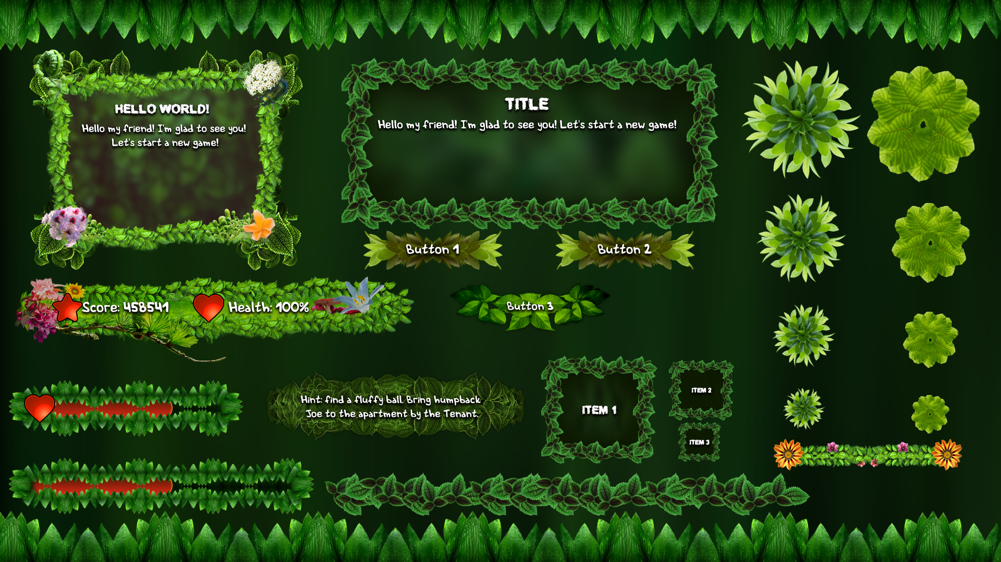
UI Asset Idea

Slide 6
Juice/Powerup Ideas (Not all will be added)
Paddle Based Ideas –
Extend Paddle – can extend paddle to max of 2.5x the base paddle. Each time you collect it you can extend by 0.5x the base paddle.
Shrink Paddle - can shrink paddle to min of 0.5x the base paddle. Each time you collect it you can extend by 0.5x the base paddle.
Shooting Paddle
Grab Ball
Lock Paddle in place for 10 seconds.
Airstrike from the top.
Ball Based Ideas –
Multiply Balls by 2x – can have max of 16 balls.
Increase Ball Speed by 2x.
Decrease Ball Speed for a time of 10 seconds.
Increase Ball Size.
Decrease Ball Size.
Thu-Brick – Destroy All brick in the incoming path for next 10 seconds.
Gameplay Based Ideas –
Elemental Tile & Ball types – electricity, water, fire, earth, etc.
Elemental Weapons for Paddle.
Elemental combination (goes in conjunction with any of the above).
Kill Paddle
Extra life
2x/3x Score multiplier for next 5,10,15 seconds.
Go to Next Level.
Multiply certain type of tile.
Invert Paddle and Pit – paddle and pit are inverted and go to the top.

Slide 7
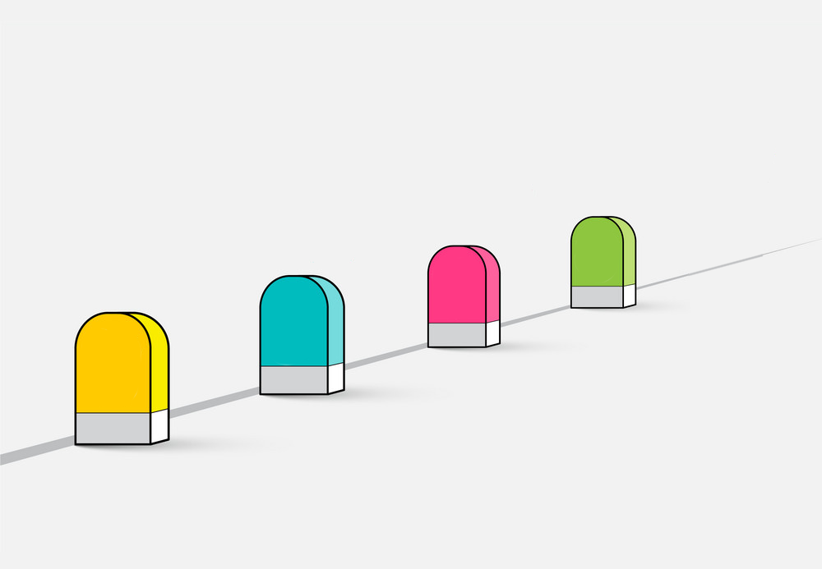
Milestones
FINAL
3rd
2nd
1St

Slide 8
Milestone 1 Deliverables
A Menu System with Main Menu and in game HUD with a controllable paddle with a test level with different brick types and some power ups.
Player controls Paddle with Mouse Movement.
Player can use the Menu using Mouse or Keyboard.
Non-Persistent High Score system where players can enter their name for up to maximum of 10 top scores.
Main menu with some sub menus like settings, controls (only for display) and high score menu.
Data driven gameplay components like -
tiles types, tile assets, paddle asset, etc.
Configurable Settings like –
Base Paddle Size, Max Paddle Size, Min Paddle Size, etc.
Some basic ball and paddle powerups.
Simpler Physics system for collisions between ball and paddle and ball and the tiles. (the current system lacks performance).
Stress testing Physics system for performance.
Setup Initial Test Level.

Slide 9
Milestone 2 Deliverables
Adding in particle effects, levels and powerups.
Adding in a 2D-Particle system.
Integrating Particle system with tiles.
Screen-Shake effects.
Finalizing 3 levels / level generation technique.
Scoring mechanics based on how the tile is destroyed.
In game HUD to display score level number and current lives.
Finalizing powerups.
Stretch goals (Based On Game Feel)
Integrating Particle system with the ball.
Environmental Hazards.
PCG for level generation (I’d like there to be patterns rather than random worms).

Slide 10
Milestone 3 Deliverables
Adding in Audio, Saving the data, polish & refinement.
Saving High Score Data.
Refining Menus.
Game over screen displaying your score and displaying all the high scores where you can enter name if you beat a high score and a return to main menu button.
RNG based Power Drop on tile breaks.
Adding in audio effects for different tiles breaking and background audio.
Audio for the Menus.
Stretch Goals / PAST mILEstone dependent goals
Adding in More levels

Slide 11
Final Milestone Deliverables
Final polish, bug fixing and some more UI & levels.
Pause Menu
Tutorials Menu
Stretch Goals / mILEstone 2 dependent goals
Additional Levels if procedural generation is not used for infinite level generation.

Slide 12
References
Piffle Game
Brick breaking person
Dx-Ball 2
Grove Flowers
Orange Squeeze
Great Idea
Milestones

Slide 13
QUESTIONS ?

Slide 14

THANK YOU

